Slide 1

WNE UW
Topic 4b: Consumer Choice Buying and Selling; exchange economy
Notes:
1

Slide 2
The simplest building block of general equilibrium
From standard budget constraint to endowment budget constraint.
From individual demand and supply to an exchange economy with many markets.
Goal: build the simplest working building block of general equilibrium – a pure exchange economy.

Slide 3
The simplest building block of general equilibrium
To get the simplest functioning element of general equilibrium we only need two ingredients:
  1. Endowment budget constraint.
  2. Walras's law.
Together they give us the simplest model of an exchange economy. From today’s perspective it looks trivial, but at the end of the 19th century it changed how economists thought. Economics became mathematical instead of purely descriptive or deductive.

Slide 4
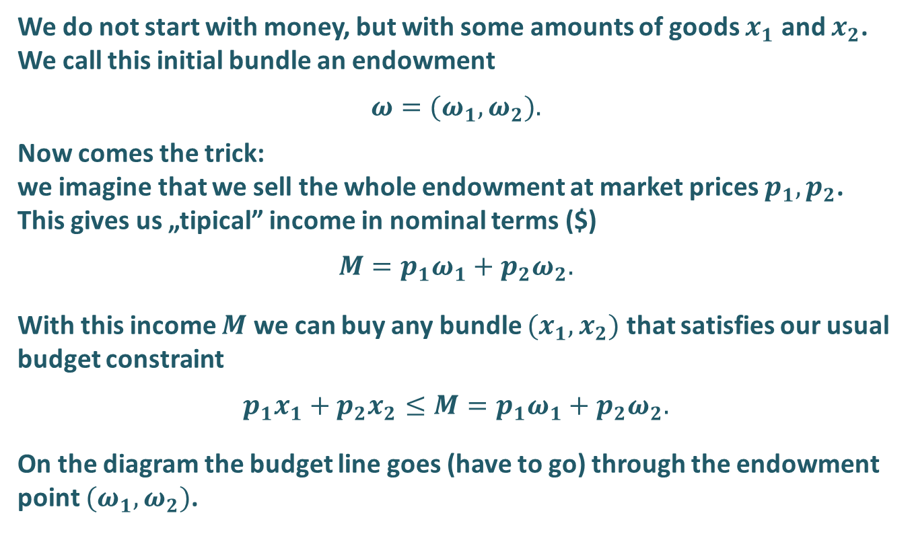
Endowment budget constraint
We do not start with money, but with some amounts of goods $x_{1}$ and $x_{2}$. We call this initial bundle an endowment
$$ω=(ω_{1},ω_{2}).$$
Now comes the trick:
we imagine that we sell the whole endowment at market prices $p_{1},p_{2}$. This gives us „tipical” income in nominal terms ($)
$$M=p_{1}ω_{1}+p_{2}ω_{2}.$$
With this income $M$ we can buy any bundle $(x_{1},x_{2})$ that satisfies our usual budget constraint
$$p_{1}x_{1}+p_{2}x_{2}≤M=p_{1}ω_{1}+p_{2}ω_{2}.$$
On the diagram the budget line goes (have to go) through the endowment point $(ω_{1},ω_{2})$.
x₂
ω₂
ω₁
x₁

Slide 5
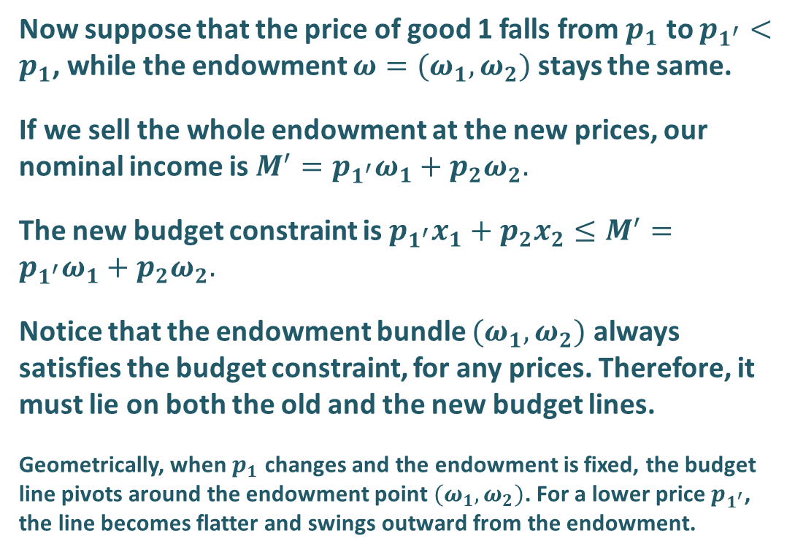
Endowment budget constraint – price change
Now suppose that the price of good 1 falls from $p_{1}$ to $p_{1^{′}}<p_{1}$, while the endowment $ω=(ω_{1},ω_{2})$ stays the same.
If we sell the whole endowment at the new prices, our nominal income is $M^{′}=p_{1^{′}}ω_{1}+p_{2}ω_{2}.$
The new budget constraint is $p_{1^{′}}x_{1}+p_{2}x_{2}≤M^{′}=p_{1^{′}}ω_{1}+p_{2}ω_{2}.$
Notice that the endowment bundle $(ω_{1},ω_{2})$ always satisfies the budget constraint, for any prices. Therefore, it must lie on both the old and the new budget lines.
Geometrically, when $p_{1}$ changes and the endowment is fixed, the budget line pivots around the endowment point $(ω_{1},ω_{2})$. For a lower price $p_{1^{′}}$, the line becomes flatter and swings outward from the endowment.
$$p_{1^{′}}x_{1}+p_{2}x_{2}≤M^{′}=p_{1^{′}}ω_{1}+p_{2}ω_{2}$$
x₂
w₂
w₁
x₁

Slide 6
Endowment budget constraint – price change
Given prices p₁, p₂ and endowment ω = (ω₁, ω₂) the consumer chooses an optimal bundle (x₁*, x₂*).
Define net demand (excess demand) for good i:
z_{i} = x_{i}* − ω_{i} for i = 1, 2
If z_{i} > 0: the consumer is a net buyer of good i (demands z_{i} units).
If z_{i} < 0: the consumer is a net seller of good i (supplies −z_{i}).
On the diagram, the distance between ω_{i} and x_{i}* shows z_{i}.
x2
x2*
net buyer
ω 2
net seller
x1*
ω1
x1

Slide 7
Net buyer / net seller cases
x₂
Case 1: net buyer of x1, net seller of x2:
z1 = x1* − ω1 > 0 (buys x1)
z2 = x2* − ω2 < 0 (sells x2)
x₂
Case 2: net buyer of x2, net seller of x1:
z2 = x2* − ω2 > 0 (buys x2)
z1 = x1* − ω1 < 0 (sells x1)
x₂*
w₂
w₂
x₂*
x₁*
w₁
x₁
w₁
x₁*
x₁
This is how individual demand and supply are generated from →
One optimization problem with an endowment.

Slide 8
From micro to macro: many markets
We can now scale up from one consumer and two goods to many consumers and many markets.
Each consumer h:
• maximises utility subject to an endowment budget constraint,
• generates net demands z_{i}(p) for all goods i = 1,…,N.
We focus only on exchange and its efficiency and ignore where the endowments come from.

Slide 9
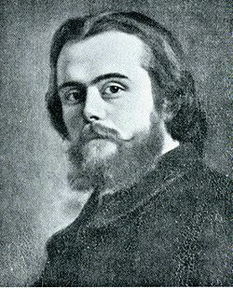
Léon Walras (1834–1910)
Historically the first fully explicit approach to general equilibrium.
Walras modelled an entire economy as a system of markets that clear simultaneously via price adjustments.
Central idea: Walras's law – a property of economies in which every agent always satisfies their budget constraint.
Léon Walras

Slide 10
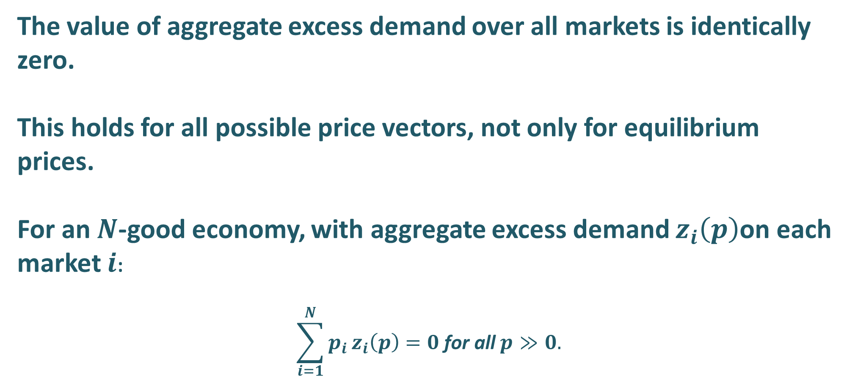
Walras' law – basic statement
The value of aggregate excess demand over all markets is identically zero.
This holds for all possible price vectors, not only for equilibrium prices.
For an $N$-good economy, with aggregate excess demand $z_{i}\left(p\right)$on each market $i$:
$$\sum_{i=1}^{N}{p_{i}}z_{i}\left(p\right)=0 \text{for} \text{all} p≫0.$$

Slide 11
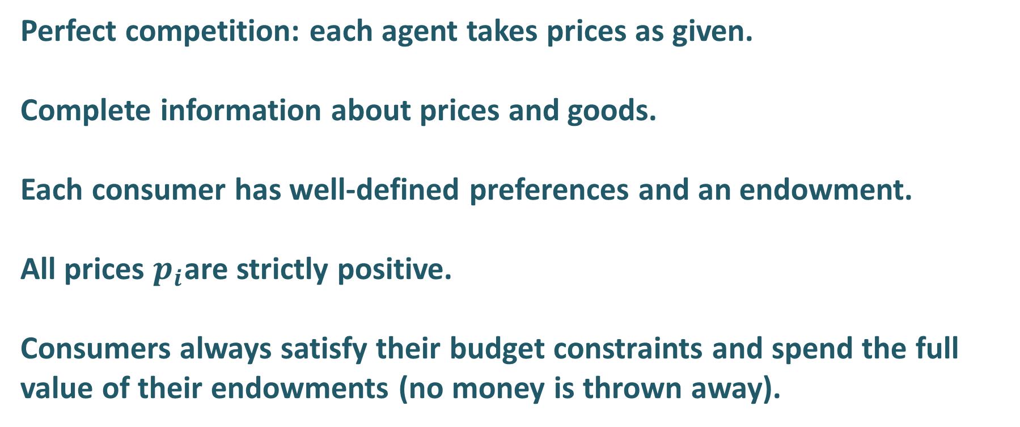
Assumptions of the Walrasian exchange model
Perfect competition: each agent takes prices as given.
Complete information about prices and goods.
Each consumer has well-defined preferences and an endowment.
All prices $p_{i}$are strictly positive.
Consumers always satisfy their budget constraints and spend the full value of their endowments (no money is thrown away).

Slide 12
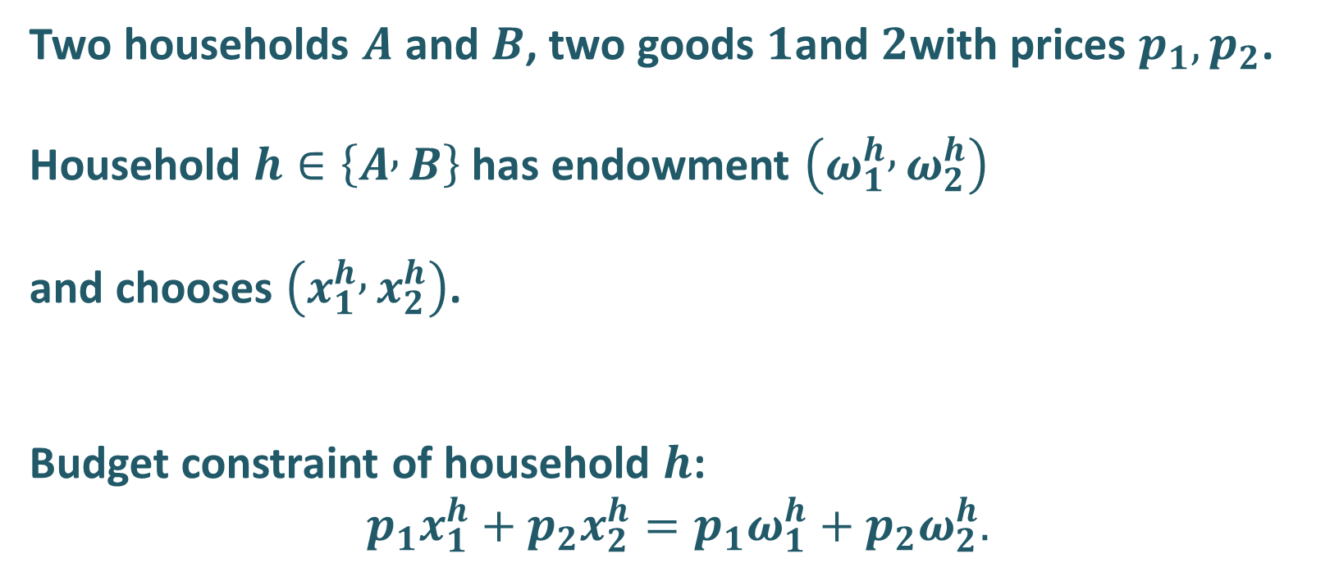
Budget constraints for two households and two goods
Two households $A$ and $B$, two goods $1$and $2$with prices $p_{1},p_{2}$.
Household $h∈\left\{A , B\right\}$ has endowment $\left(ω_{1}^{h} , ω_{2}^{h}\right)$
and chooses $\left(x_{1}^{h} , x_{2}^{h}\right)$.
Budget constraint of household $h$:
$$p_{1}x_{1}^{h}+p_{2}x_{2}^{h}=p_{1}ω_{1}^{h}+p_{2}ω_{2}^{h}.$$

Slide 13

Walras' law from individual budget constraints
Add the budget constraints of $A$ and $B$ side by side:
$$p_{1}x_{1}^{A}+p_{2}x_{2}^{A}=p_{1}ω_{1}^{A}+p_{2}ω_{2}^{A},$$
$$p_{1}x_{1}^{B}+p_{2}x_{2}^{B}=p_{1}ω_{1}^{B}+p_{2}ω_{2}^{B}.$$
Summing over $h∈\{A,B\}$:
$$\sum_{h}^{​}{\left(p_{1}x_{1}^{h}+p_{2}x_{2}^{h}\right)}=\sum_{h}^{​}{\left(p_{1}ω_{1}^{h}+p_{2}ω_{2}^{h}\right)}.$$
Rearrange terms:
$$p_{1}\sum_{h}^{​}{\left(x_{1}^{h}−ω_{1}^{h}\right)}+p_{2}\sum_{h}^{​}{\left(x_{2}^{h}−ω_{2}^{h}\right)}=0.$$
Define aggregate excess demand:
$$z_{i}(p)=\sum_{h}^{​}{\left(x_{i}^{h}(p)−ω_{i}^{h}\right)},$$
then Walras’ law becomes
$$p_{1}z_{1}(p)+p_{2}z_{2}(p)=0.$$

Slide 14
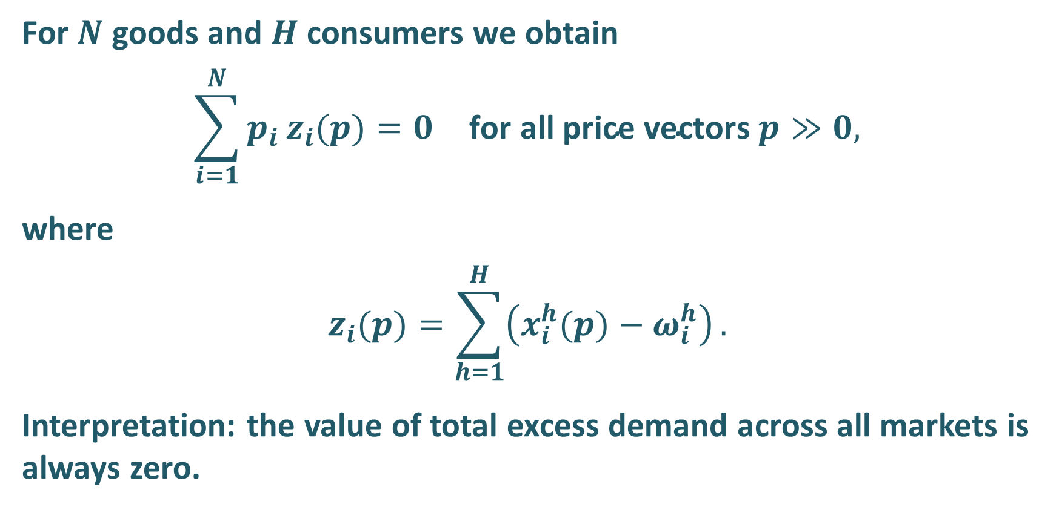
Walras' law – general N-good form
For $N$ goods and $H$ consumers we obtain
$$\sum_{i=1}^{N}{p_{i}}z_{i}(p)=0 \text{for} \text{all} \text{price} \text{vectors} p≫0,$$
where
$$z_{i}(p)=\sum_{h=1}^{H}{\left(x_{i}^{h}(p)−ω_{i}^{h}\right)}.$$
Interpretation: the value of total excess demand across all markets is always zero.

Slide 15
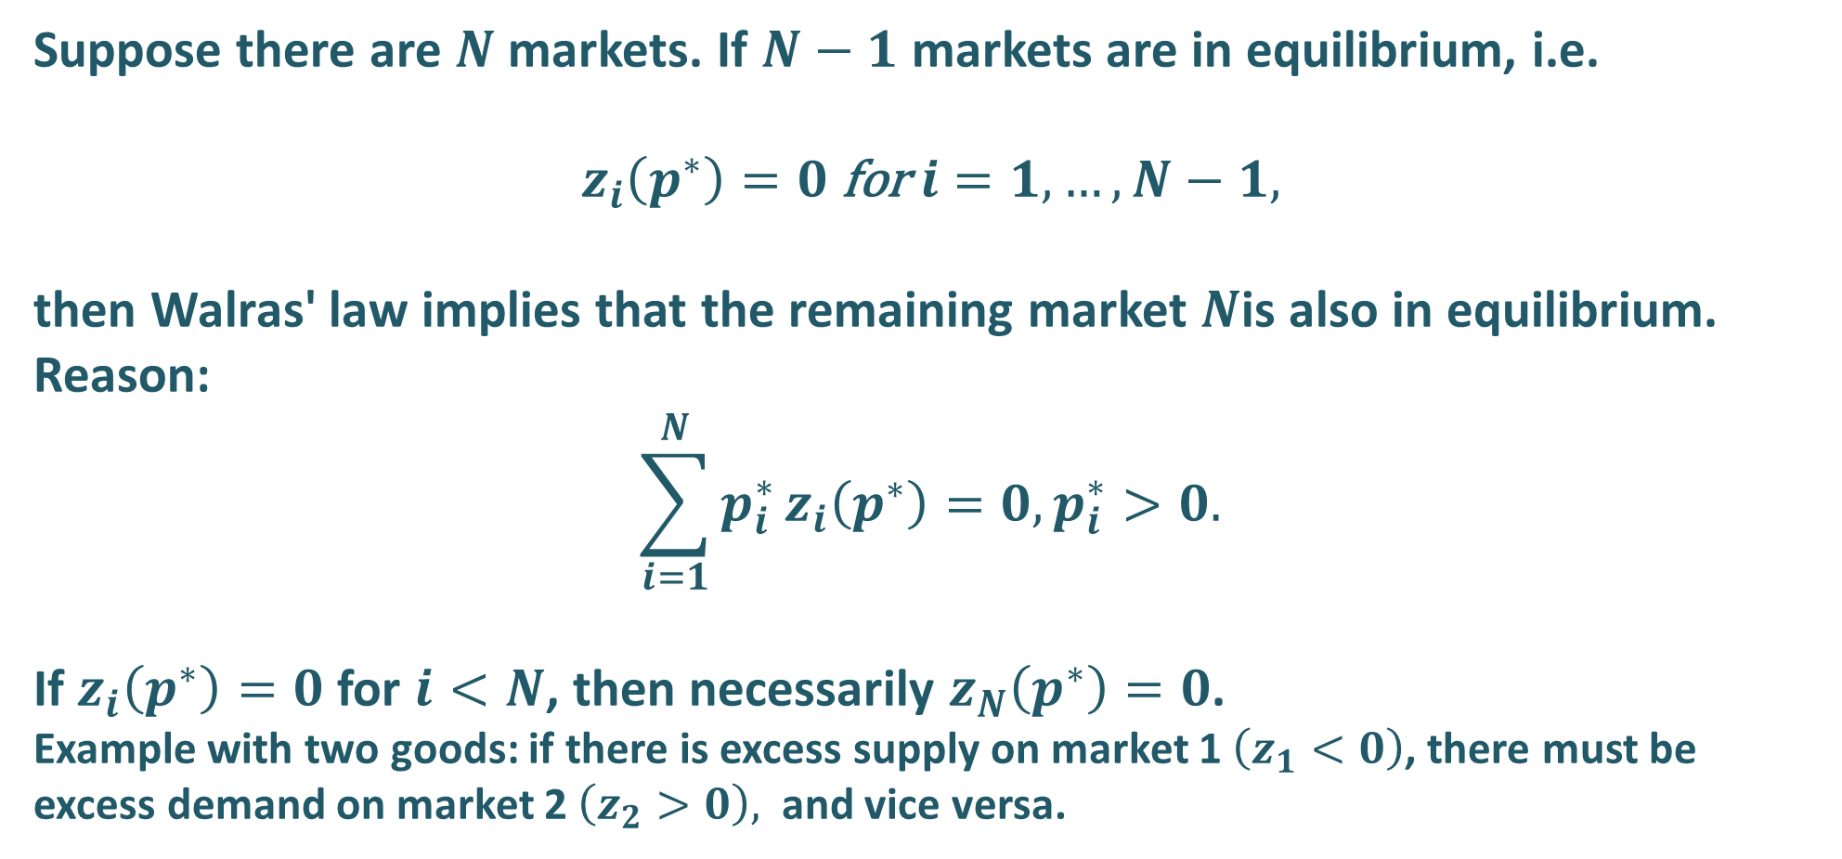
Walras' law – market-clearing implication
Suppose there are $N$markets. If $N−1$ markets are in equilibrium, i.e.
$$z_{i}\left(p^{∗}\right)=0 \text{for} i=1,…,N−1,$$
then Walras' law implies that the remaining market $N$is also in equilibrium. Reason:
$$\sum_{i=1}^{N}{p_{i}^{∗}}z_{i}\left(p^{∗}\right)=0, p_{i}^{∗}>0.$$
If $z_{i}\left(p^{∗}\right)=0$for $i<N$, then necessarily $z_{N}\left(p^{∗}\right)=0$.
Example with two goods: if there is excess supply on market 1 $\left(z_{1}<0\right)$, there must be excess demand on market 2 $\left(z_{2}>0\right),$ and vice versa.

Slide 16
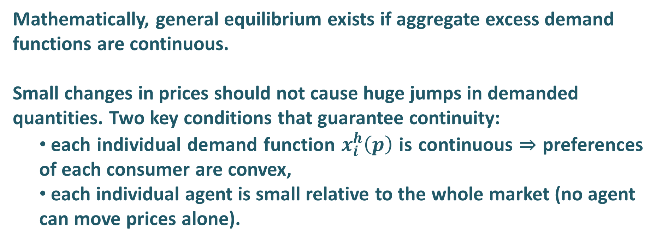
Implications: continuity of excess demand
Mathematically, general equilibrium exists if aggregate excess demand
functions are continuous.
Small changes in prices should not cause huge jumps in demanded quantities. Two key conditions that guarantee continuity:
  each individual demand function $x_{i}^{h}\left(p\right)$ is continuous ⇒ preferences of each consumer are convex,
  each individual agent is small relative to the whole market (no agent can move prices alone).

Slide 17
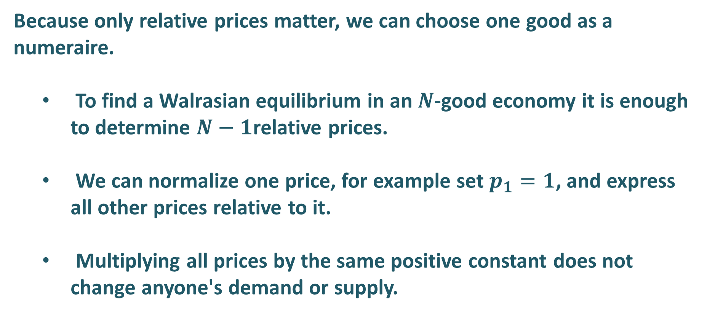
Implications: numeraire and relative prices
Because only relative prices matter, we can choose one good as a numeraire.
  To find a Walrasian equilibrium in an $N$-good economy it is enough to determine $N−1$relative prices.
  We can normalize one price, for example set $p_{1}=1$, and express all other prices relative to it.
  Multiplying all prices by the same positive constant does not change anyone's demand or supply.

Slide 18
Implications: link to Pareto efficiency
In a pure exchange economy with convex preferences and perfect competition, any Walrasian equilibrium allocation is Pareto-efficient (First Welfare Theorem).
Endowment matters: different initial endowments lead to different efficient allocations, but all of them are Pareto-efficient.
We will return to this when we discuss justes in economics.

Slide 19
Implications: link to Pareto efficiency
Walras’ law looks innocent in our diagrams: if all markets clear, the value of total excess demand is zero. But once we leave our two-good exchange world, this becomes a very strong story about how the economy works. In the neoclassical macro narrative, labour is treated just like any other good. Then, if all goods markets are in equilibrium, Walras’ law seems to force the conclusion that the labour market must also be in equilibrium – so persistent, involuntary unemployment should not exist.
Keynesian reasoning challenges this story not by rejecting Walras’ law, but by changing the cast of markets in the model. When we add money and financial assets as additional “goods”, Walras’ law only says that the sum of excess demands (for goods, labour, money, bonds, etc.) is zero. It becomes perfectly possible to have goods markets in equilibrium, excess supply of labour (unemployment), and at the same time excess demand for money or safe assets (for example, in a liquidity trap).
So, the real methodological lesson from Walras’ law is this: the law itself is simple and general, but its implications depend entirely on which markets we choose to model and how we tell the story of the economy. This tension between the neat neoclassical tale and the Keynesian one will be our starting point next time, when we look more closely at equilibrium in a richer setting.

Slide 20
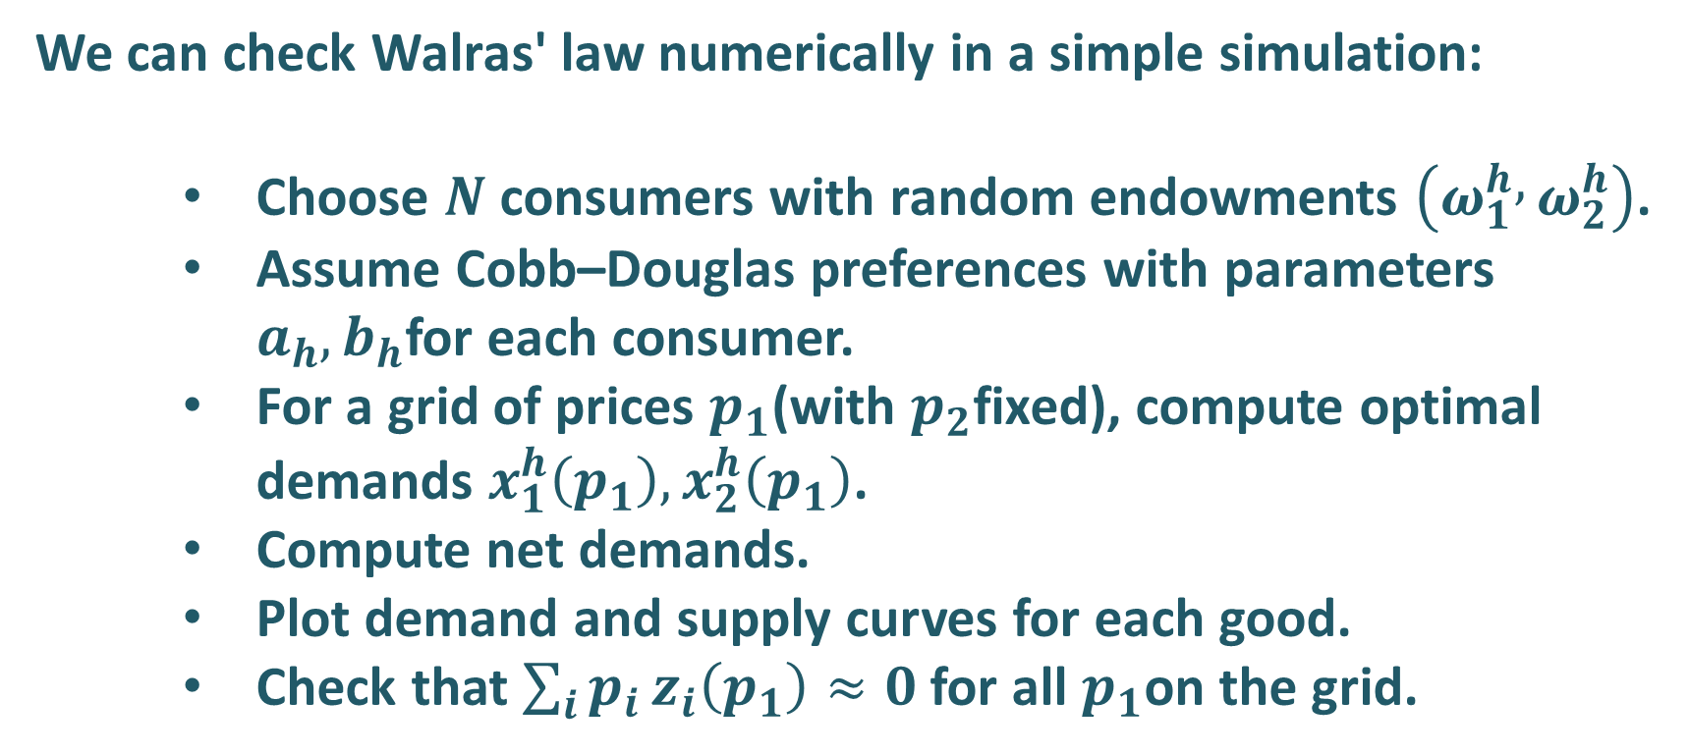
Simulation of Walras' law – idea
We can check Walras' law numerically in a simple simulation:
    Choose $N$ consumers with random endowments $\left(ω_{1}^{h} , ω_{2}^{h}\right)$.
    Assume Cobb–Douglas preferences with parameters $a_{h},b_{h}$for each consumer.
    For a grid of prices $p_{1}$(with $p_{2}$fixed), compute optimal demands $x_{1}^{h}\left(p_{1}\right),x_{2}^{h}\left(p_{1}\right)$.
    Compute net demands.
    Plot demand and supply curves for each good.
    Check that $\sum_{i}{p_{i}}z_{i}\left(p_{1}\right)≈0$for all $p_{1}$on the grid.

Slide 21
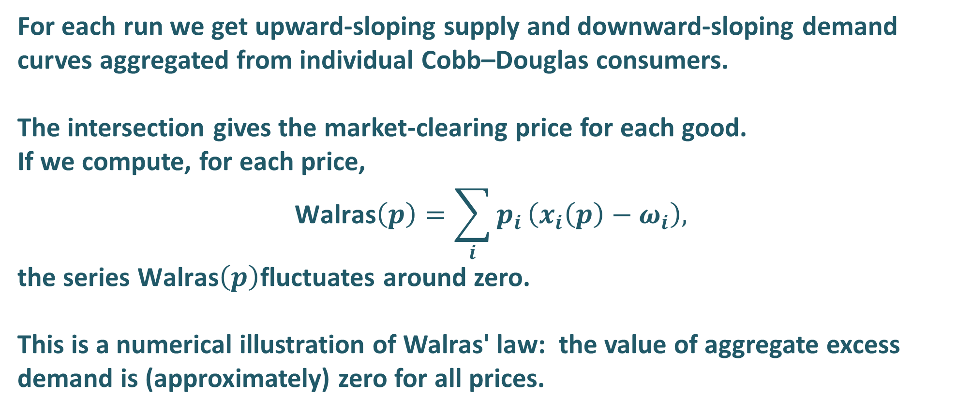
Simulation of Walras' law – results
For each run we get upward-sloping supply and downward-sloping demand curves aggregated from individual Cobb–Douglas consumers.
The intersection gives the market-clearing price for each good.
If we compute, for each price,
$$\text{Walras}\left(p\right)=\sum_{i}{p_{i}}\left(x_{i}\left(p\right)−ω_{i}\right),$$
the series $\text{Walras}\left(p\right)$fluctuates around zero.
This is a numerical illustration of Walras' law: the value of aggregate excess demand is (approximately) zero for all prices.

Slide 22
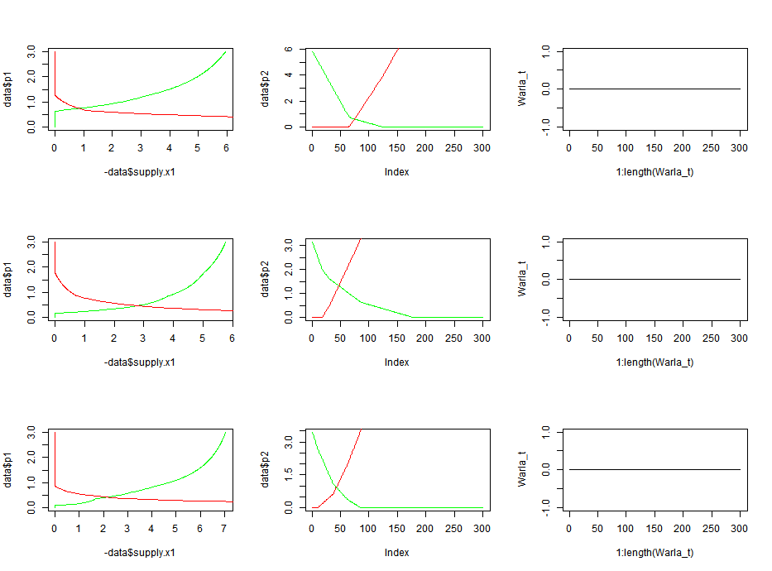
Simulation of Walras' law – results
########### Section 0 ############################################# Check, installation and loading of required packages ##########requiredPackages = c("raster", "lattice", "latticeExtra", "ggplot2", "RColorBrewer") # list of packages add new packages and run the code for(i in requiredPackages) {if(!require(i,character.only = TRUE)) install.packages(i)} for(i in requiredPackages) {library(i,character.only = TRUE)}###################### End ########################################par(mfrow = c(3, 3))for(i in 1:3) {step <- 0.01p1.min.max <- c(0.01,3)p2.min.max <- c(0.01,3)N <- 4p1 <- seq(p1.min.max[1],p1.min.max[2],step)p2 <- 1data <- as.data.frame(p1)omega1 <-matrix(rep(sample(1:5,N ,replace = TRUE), nrow(data)), ncol = N, byrow = TRUE )omega2 <-matrix(rep(sample(1:5,N ,replace = TRUE), nrow(data)), ncol = N, byrow = TRUE )a <- matrix(rep(sample((3:7)/10,N, replace = TRUE ), nrow(data)), ncol = N, byrow = TRUE)b <- 1.3 - ax1 <- a*(p1*omega1 + p2*omega2)/((b+a)*p1)x2 <- b*(p1*omega1 + p2*omega2)/((b+a)*p2)e.demand.x2 <- (x2 - omega2)demand.x2 <- ifelse(e.demand.x2 > 0,e.demand.x2,0)supply.x2 <- ifelse(e.demand.x2 < 0,e.demand.x2,0)data$demand.x2 <- rowSums(demand.x2)data$supply.x2 <- rowSums(supply.x2)e.demand.x1 <- (x1 - omega1)demand.x1 <- ifelse(e.demand.x1 > 0,e.demand.x1,0)supply.x1 <- ifelse(e.demand.x1 < 0,e.demand.x1,0)data$demand.x1 <- rowSums(demand.x1)data$supply.x1 <- rowSums(supply.x1)plot(- data$supply.x1, data$p1,type = "l", col= "green")lines(data$demand.x1, data$p1,col= "red")plot(- data$supply.x2, data$p2,type = "l", col= "green")lines(data$demand.x2, data$p2,col= "red")Warla_t <- rowSums(round (p1*(x1 - omega1) + p2*(x2 - omega2), 3)) plot(1:length(Warla_t),Warla_t ,type = "l")}

Slide 23
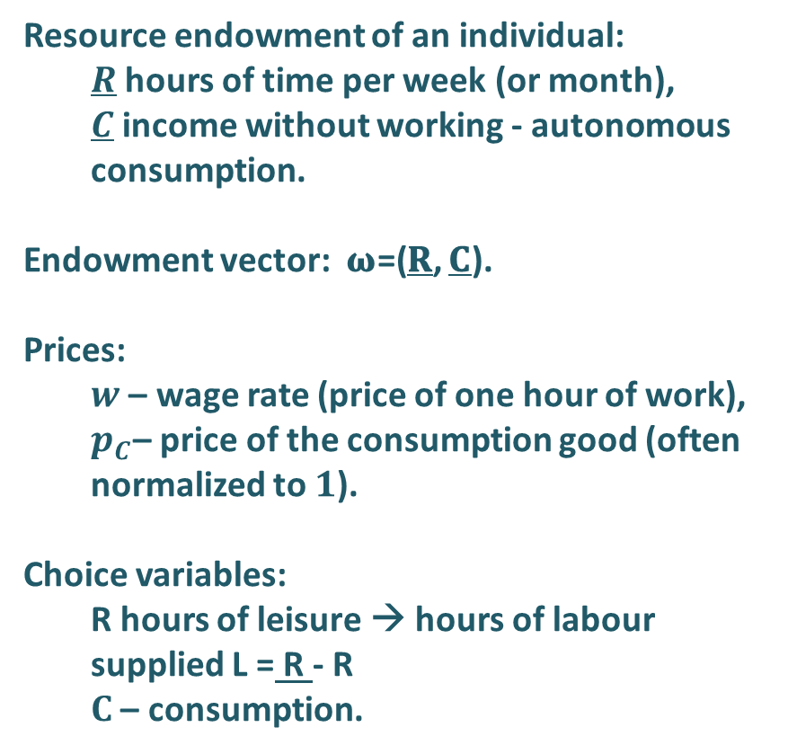
Application: labour supply from an endowment constraint
Resource endowment of an individual:
  $R$ hours of time per week (or month),
  $C$ income without working - autonomous consumption.
Endowment vector: 𝛚=(𝐑, 𝐂).
Prices:
  $w$ – wage rate (price of one hour of work),
  $p_{C}$– price of the consumption good (often normalized to $1$).
Choice variables:
  R hours of leisure → hours of labour supplied L = R - R
  $C$ – consumption.
C
C*
Endowment vector:
𝛚=(𝐑, 𝐂).
C
R*
R
R
R - leasure
hours of labour L

Slide 24


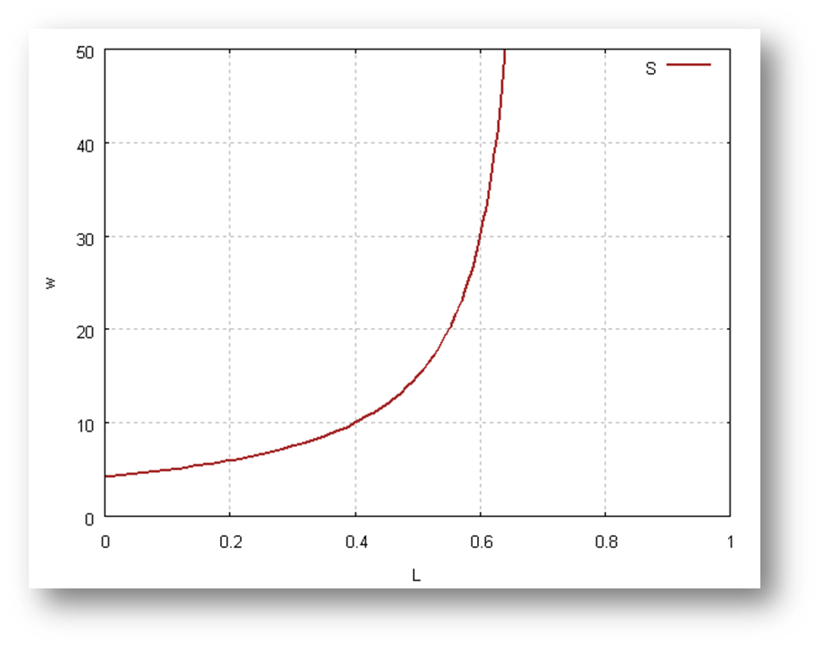
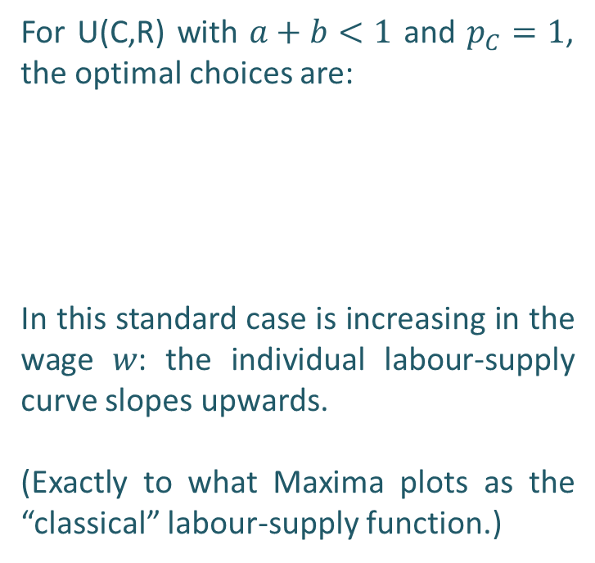
Labour supply – classical Cobb–Douglas solution
kill(all)$
load(draw);
assume(R>0, C>0,p>0,w>0,u>0,a>0,a<1,lambda>0, C_A>0)$
U:C^a*R^b;
LAGRANGIAN:(U)+lambda*((w*(1-R)+C_A)-C);
eq1:diff(LAGRANGIAN,C,1)=0;
eq2:diff(LAGRANGIAN,R,1)=0;
eq3:diff(LAGRANGIAN,lambda,1)=0;
solve([eq1,eq2,eq3],[C,R,lambda]);
FOC:%[1]; /* wyci¹gniecie z pierwszego nawiasu*/
C:rhs(FOC[1]);
R:rhs(FOC[2]);
lambda:rhs(FOC[3]);
C_A:10;
a:0.7;
b:0.3;
eq4:L=1-R;
solve([eq4],[w]);
w:rhs(%[1]);
w:''w;
kill(L);
draw2d(yrange = [0,50],xrange = [0,1],grid = true, xlabel = "L", ylabel = "w", line_width = 2,
color = brown, key = "S",explicit(w,L,0.001,130))$
For U(C,R) with $a+b<1$ and $p_{C}=1$, the optimal choices are:
In this standard case is increasing in the wage 𝑤: the individual labour-supply curve slopes upwards.
(Exactly to what Maxima plots as the “classical” labour-supply function.)

Slide 25
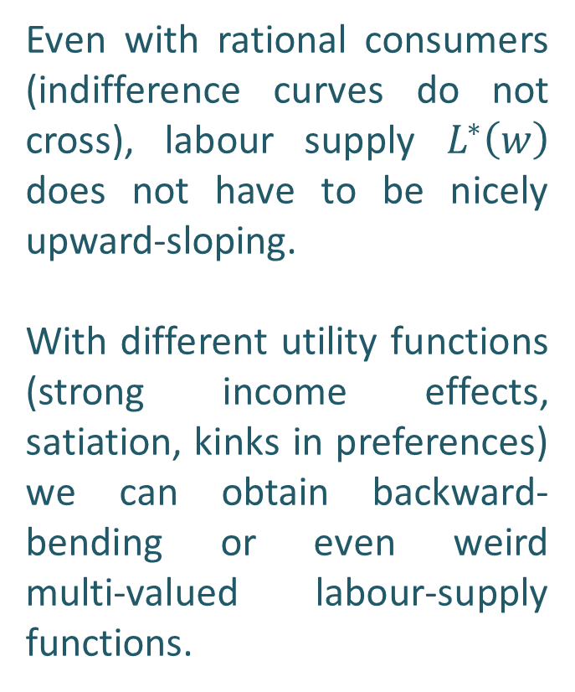
Labour supply – when rationality is not enough
Even with rational consumers (indifference curves do not cross), labour supply $L^{∗}\left(w\right)$ does not have to be nicely upward-sloping.
With different utility functions (strong income effects, satiation, kinks in preferences) we can obtain backward-bending or even weird
multi-valued labour-supply functions.
Even if leisure is a normal good and consumers are fully rational (indifference curves do not cross), labour supply L*(w) does not have to be nicely upward-sloping.
Think of leisure time R as a consumption normal good and of the wage w as the “price of leisure”: the opportunity cost of one hour of free time is the wage you give up.
When wages are low, a higher w mainly increases the reward from working, so people work more. When wages are already high, a further increase in w also makes it easier to afford more leisure, so beyond some point people may want to work less and enjoy more free time.
C
R

Slide 26
Labour supply – when rationality is not enough
w
C
S
w*
D
R
L

Slide 27
Labour supply – when rationality is not enough
w
Unstable Equlibrium
w*
S
Stable Equlibrium
D
L
L*

Slide 28
When rationality is not enough and we have instability in our paradise
This is a good example of why, in general equilibrium, we need many extra assumptions that are not implied by “rationality” alone.
The Sonnenschein–Mantel–Debreu Theorem (the “core instability” of general equilibrium – a bit of the schizophrenia of economics) shows that, with very standard rational, convex preferences, almost any shape of aggregate excess demand is possible. To get nice, stable and unique equilibria we must impose many additional assumptions – this is why we love CD and CES utility functions.
We will come back to this result in the next class, when we look more closely at equilibrium itself.

